Slide 1
Going Faster
Final Glides

Slide 2
Agenda
What You Can Gain
What You Can Lose
Golden Rules of Final Glides
Flight Analysis
Ian Reekie
Alex Hipple
Geoff Glasebroke
Ryan Berry

Slide 3
What you can Gain
Minimise the Inefficiency:
Steepest glide angle, highest speed in straight line
Ideally: follow similar achieved glide as rest of flight
But only if you are totally mad!
Good final glides can win days
Can gain several minutes by well judged final glides
Leaving with enough height for safety
Don’t pad your safety margin
Win and Lose competitions by 30s
2 turns more/less on one final glide…

Slide 4
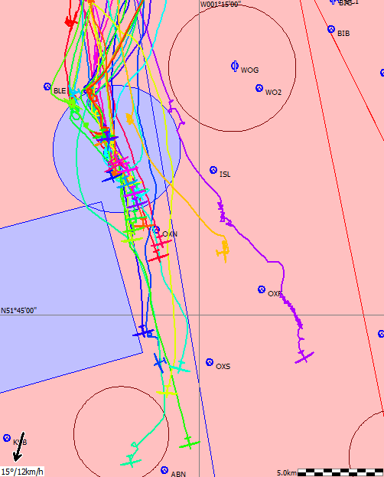
18m Day 4, top of last climb
Position at Start of FG
25km behind front at 5k ft
Last climb 4.7Kt, 63:1 to finish
Other glider positions
48/8: higher, +5km
LT: same height, 12k
What Happens
Main pack climbs twice more
Front runners get bogged and climb at 2-3Kt

Slide 5
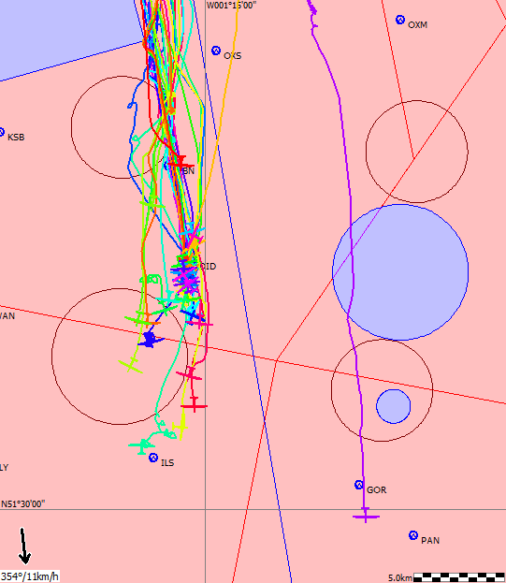
Everyone Stops at Didcot
Then catch up:
Maintained height:
Others stop to climb
Low gliders are covered
630 climbs at 2.5kt
LT at 40:1, 3.5k- should get back
Others stop in groups
Two main gaggles
Neither needed to stop

Slide 6
Different Heights on final run home
Higher and Faster
Safe but wasteful
Not needed for big wings
Lower and Slower
Conserving height
Similar slope to G9
Performance Counts
G9: Definite advantage at high speed
105kph at top of last
116kph at end of FG

Slide 7
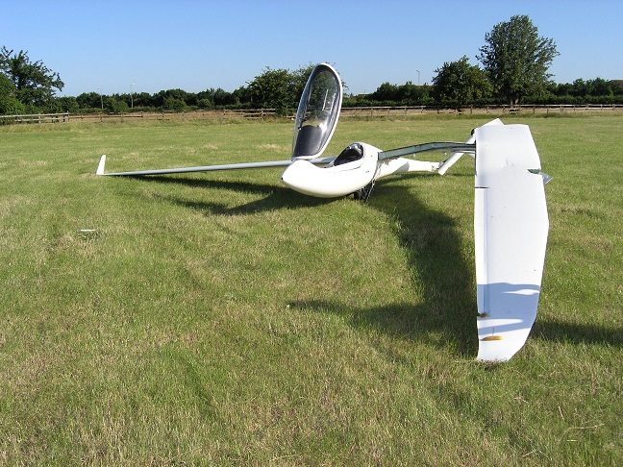
What you can Lose
Over-do it: climb away low and slow
Maybe lose 5 minutes or more
Worst case land out…
Or even…
Blue, high, ‘safe’
Lots of sink in streets
Bicester from NW
No option to get low
Private accident…
Rather than houses and play ground

Slide 8
Undershooting
What is an Undershoot
If you are getting back, into wind, but only just
Get low and fast, out of wind gradient
How to do it:
You must be sure you are getting back when you commit
Get low- less than ½ wing span, then up smoothly over obstacles
Push over gently to get ballistic trajectory (wing creates little lift)
Preparation before you Try
Get into a 2 seater and try it out with an instructor!
Be CERTAIN of field state and obstacles before doing for real
Be SURE you are getting in- it makes a marginal glide safer…

Slide 9
Golden Rules of Final Gliding
Look at fields near the site before you leave
Know your options if it starts to go wrong
Never use speed to fly above 4kts
Optimum high speed glide is 3kts StF
No modern glider is efficient above that speed
Make it Safe at 2000ft AGL
500ft in hand at chosen speed to fly; adjust speeds…
Keep Bigger Margins on Down Wind glides
Tend to get worse glides down wind
Plan your finish at 5 minutes out
Straight in or go round, which way, where to land
Say what you are going to do.

Slide 10
Conclusions
You can gain a LOT on final glides
Start thinking Final Glide at least 1 full climb short
Try to bounce it up but don’t ‘chase it’
Great feeling when it works!
Keep your nerve but keep it safe
Be safe at 2000ft, or stop and climb
Be realistic about how it is working out
Worst feeling ever- climbing at 1kt 15k short!

