Slide 1
Going Faster
Performance in the Climb

Slide 2
Agenda
When to Stop
Thermal Entry
Centring Technique
Efficient Exit
Flight Analysis
Guy Corbett; Andy Roch

Slide 3
Some General Points
Golden Rules of Climbing Well
Fly Tight, Fly Slow, Fly Smooth
Fly Really Smoothly, No Jerking About
What not to do: follow this link
Pudding stirring, jerking around the stick, holding it low down… I could go on
Get Into the Centre- use all the controls
Use all the controls, but progressively; one smooth movement
Use more control deflection if stronger, more turbulent
Use less if weaker and smoother thermals
Speed and Pitch
Modern, Heavy Gliders need to keep flying
Dropping too slow hurts your climb a lot!
Don’t hold back pressure and be super smooth in elevator

Slide 4
Fly Smooth and Not Too Slow!
Allow the Air to stay attached
Tight/Slow = smaller circle in best lift
Also means nearer the stall or separation
Big sharp control inputs result in break away
Smooth, Strong Thermals
Get tight and hold the stick still
Can get closer to the limits safely
Small Gusty Thermals
If strong, tighten into the gusts
If weaker, increase speed and open out- less critical
Always keep enough speed to keep flying if you fall out

Slide 5
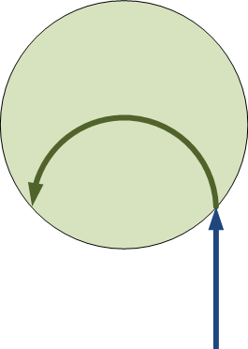
When to Stop
Get out of Pavlovian Reflex
Typical Turn is 20-30s
Takes 7-12s to traverse the thermal straight
Take your Time to slow and turn in!
Manoeuvre harder for sharper changes in lift
Which Way to turn?
Take your time- going the wrong way is EXPENSIVE
20s in sink, correction turn, full circle to get back: 1-2Min?
If in doubt- keep going straight! (take any excuse)

Slide 6
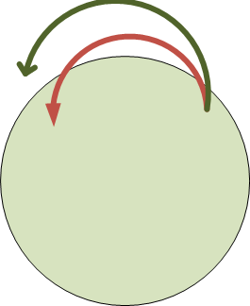
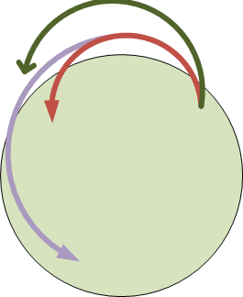
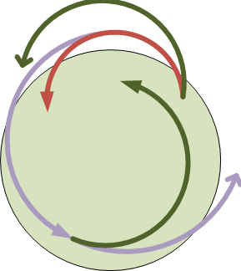
Centring Technique
Visualise and Feel with Mark 1 Vario
Respond to your seat, feel the aircraft, listen to airflow
At peak, look along the outside wing- that is where it is
At worst, look down the inside wing- MANOEVER THERE
Tighter or Open Turns to sneak up on it
Simplest Approach: Roll Out- count to 3, Roll In
Only if you have really lost the plot!
Tighten as lift reduces
Open turn as lift increases
Hit best turn rate at peak lift
Use the Aircraft Capabilities
LS7: massive roll rate, can but cant pull!
Nimbus 4: huge ability to tighten into improving lift

Slide 7
Nimbus 4 in weaker lift: open and tighten

Slide 8
Nimbus in stronger lift: Wind it In!

Slide 9
G9: Classic in, up and out into wind

Slide 10
G9: Wrong Way!

Slide 11
Exiting the Thermal
Look for the Exit Early
Know your track at least 2-3 turns before the top
Observe the cloud and plan for best air on exit
Judge when to leave
Don’t Fixate: leave when you can do better within range
Avoid: running off the edge at 100Kts to avoid cloud
Try to: Leave earlier and bounce up to base
Speed On Before Sink
Learn from previous clouds how hard to accelerate
This will change from one leg to the next!
Better to be faster in the lift and give away height
Accelerate Before the Sink!

Slide 12
Conclusions
Know your Aircraft
Experiment with speeds and angles of bank and different weight
Practice tighter, slower turns; find the limits for efficient climbing
Aim for turns of 20-25s in good conditions, 30s in weaker thermals
Entering the Thermal
Select candidates well ahead of time
Approach slightly to one side, expecting to turn one way
If you don’t hit it cleanly and positively- move on!
Centring
Fly smooth, tight and not too slow
Tighten turn in decreasing lift to cut time in weaker lift
Open out turn in increasing lift to move to the centre
Exiting
Plan ahead, find a good line and get speed on before the sink

